Slide 1


System Overview & Development Environment

Slide 2
Session - 1
Introduction to Xampp
Learning Objectives:
By the end of this lesson/module, learners will be able to:
Define XAMPP and explain its purpose as a local web server solution for web development.
Identify the components of XAMPP (Apache, MySQL/MariaDB, PHP, Perl, phpMyAdmin, etc.) and describe their individual functions.
Install and configure XAMPP on a local machine for use in developing and testing dynamic web applications.
Start, stop, and manage services (Apache and MySQL) using the XAMPP Control Panel.
Create and manage databases using phpMyAdmin within XAMPP.
Deploy and test PHP-based web applications locally using XAMPP’s web server environment.
Troubleshoot common issues related to XAMPP installation, configuration, and server operation.

Slide 3
What is xampp
XAMPP is a free, open-source software package designed to create a local web server environment on your personal computer. For training purposes, XAMPP is a fundamental tool for beginners and developers to learn, build, and test web applications (especially those using PHP and MySQL) without needing a live, internet-connected server.
It simulates a real web server environment, providing a safe, isolated space to experiment and perfect your code before deployment

Slide 4
Key Components (The Acronym) The name XAMPP is an acronym representing the core components included in the
Letter | Component | Function in Training
X | Cross-Platform | Works on multiple operating systems (Windows, macOS, Linux), making it versatile for any trainee's computer.
A | Apache | The web server software. This is what handles requests and serves your web pages to your browser, just like a server on the internet.
M | MariaDB (or MySQL) | The database management system. Used to store, retrieve, and manage the data for your dynamic websites.
P | PHP | A popular server-side scripting language. Used to create dynamic web content, interact with the database, and handle server logic.
P | Perl | A general-purpose programming language often used for system administration and various web tasks.

Slide 5
Full Steps with Detailed Description for XAMPP Installation, Backup, Restore, and Project Upload
Step 1: Download XAMPP
Visit the Apache Friends website.
Select the XAMPP version compatible with your operating system (Windows, Linux, macOS).
Download the installer (e.g., xampp-windows-x64-8.2.0-0-VS16-installer.exe).
Step 2: Start the Installation Wizard
Double-click the downloaded installer.
If prompted by Windows security, allow the installer to run.
You will see a warning from Windows UAC—click OK to proceed.

Slide 6
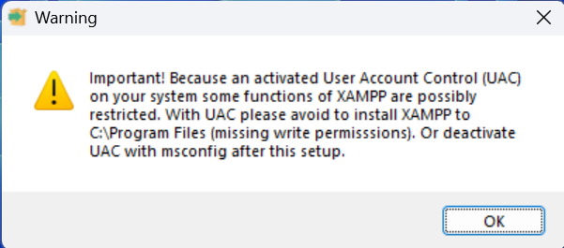

Slide 7
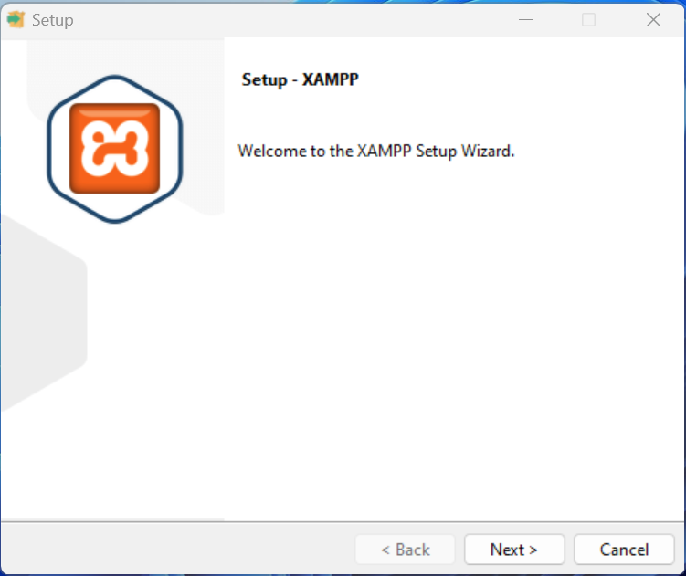
Click on Next

Slide 8
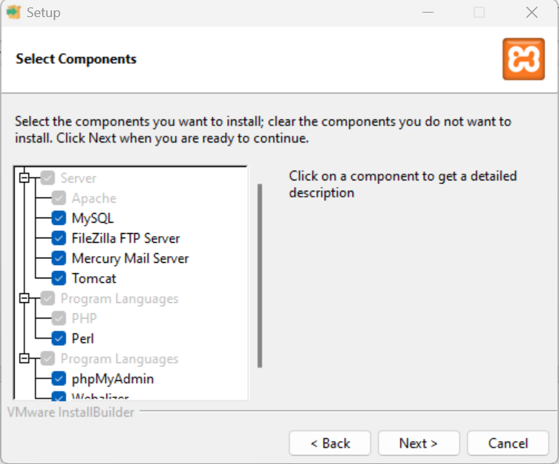
In the setup wizard, you’ll be asked to select components.
✅ Recommended (default):
Apache
MySQL
PHP
phpMyAdmin

Slide 9
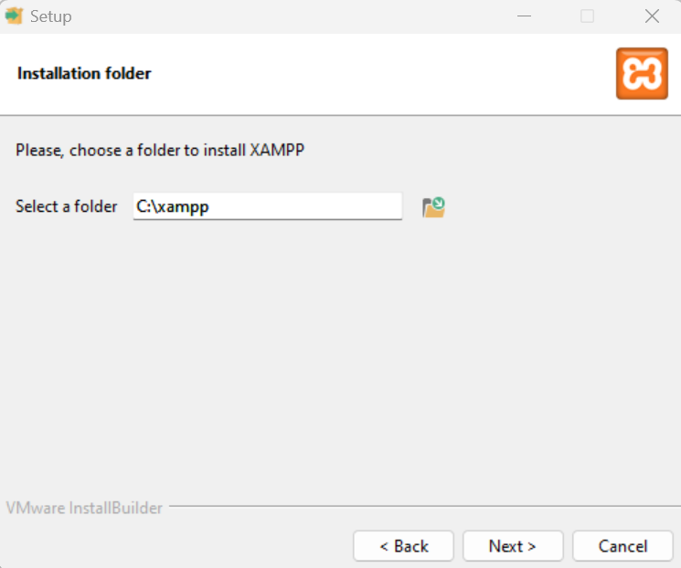
Step 4: Choose Installation Folder
Choose a folder (default is: C:\xampp)
Click Next to proceed.

Slide 10
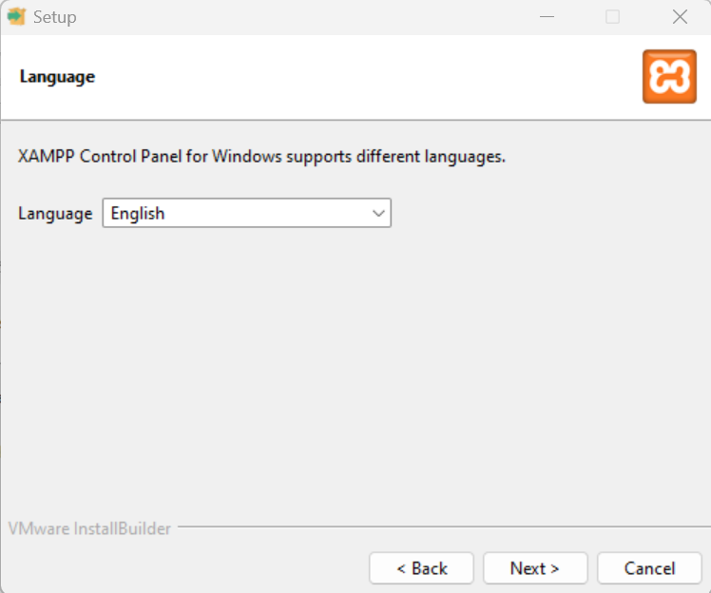
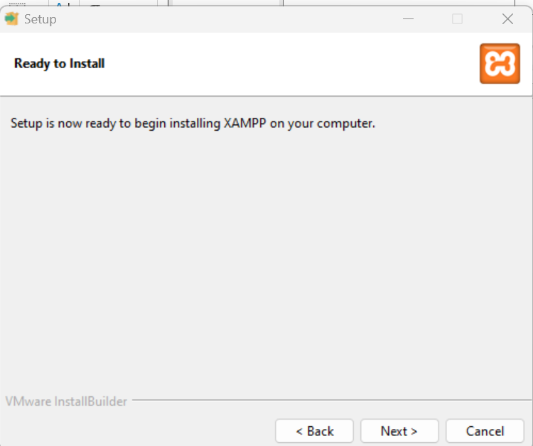
Choose Language and click on Next…

Slide 11
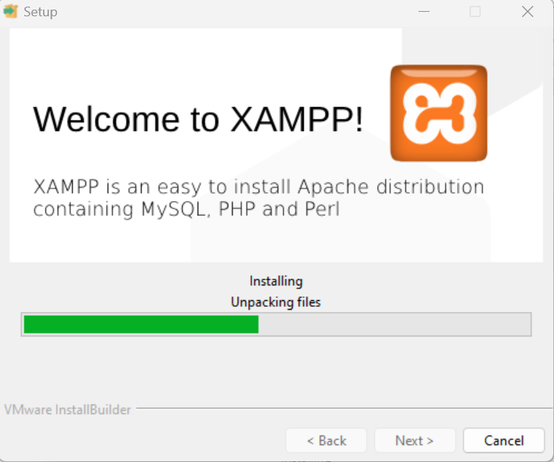

Slide 12
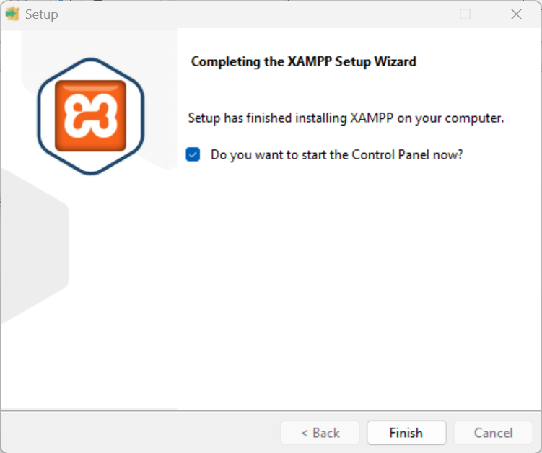
Bitnami and Shortcuts
You may be asked to install Bitnami for XAMPP. You can uncheck this.
Proceed to install.

Slide 13
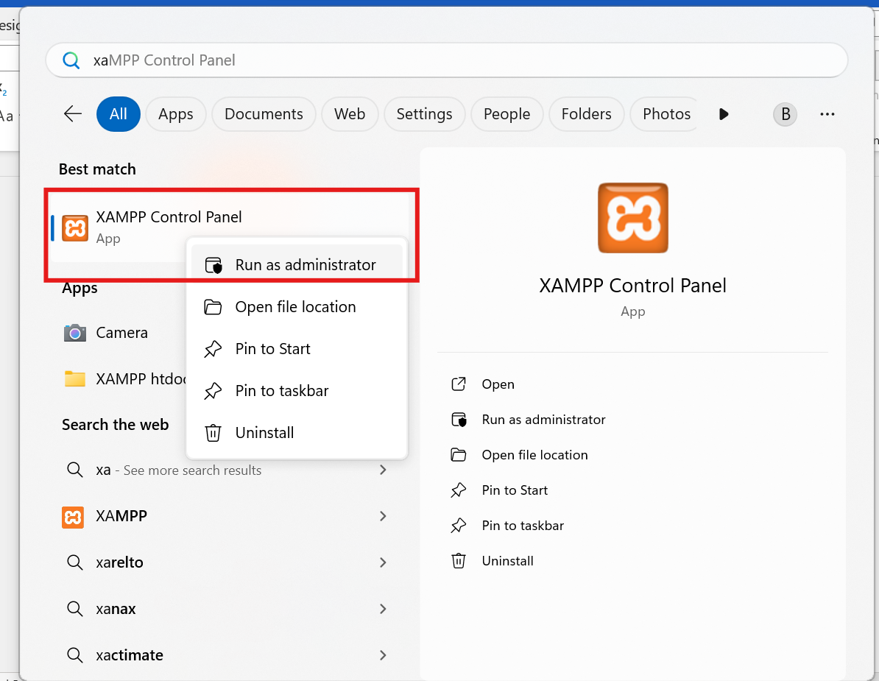
Right-click the “XAMPP Control Panel” icon on your desktop or Start Menu.
Click Run as administrator.

Slide 14
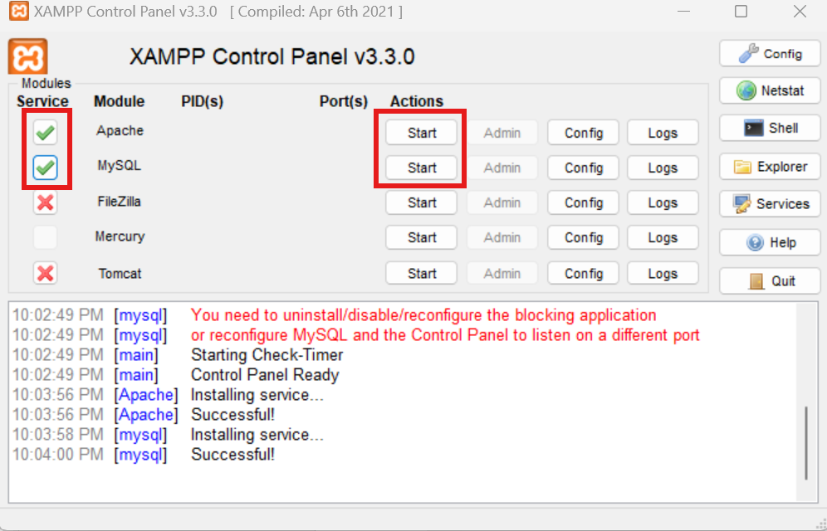
Start Apache & MySQL Services Automatically In the Control Panel: ❌ Untick Apache and MySQL from auto-start

Slide 15
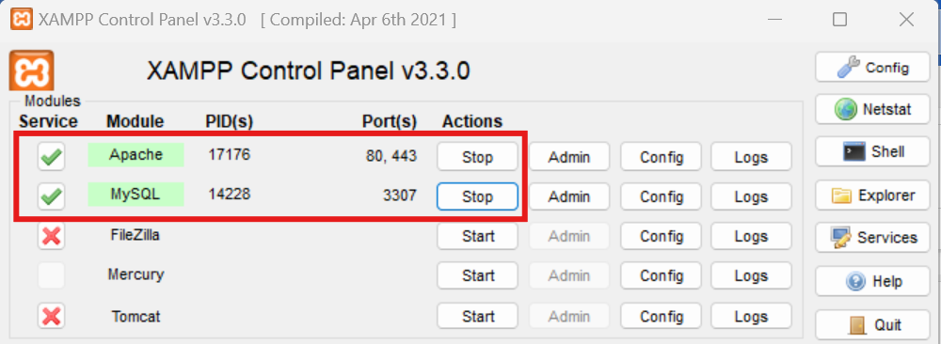
✅ Click Start next to both Apache and MySQL manually to begin services

Slide 16
Exercise 1 : Installing and Setting Up XAMPP Objective: To install, configure, and verify the proper operation of XAMPP on a local computer for use in web development.

Slide 17
Session - 2
Create and Backup
Learning Objectives: Backup Database from XAMPP
By the end of this lesson/module, learners will be able to:
Create database
Explain the importance of database backup and its role in data security and recovery.
Identify different methods of backing up databases in XAMPP (using phpMyAdmin, command line, and manual file backup).
Perform a database backup using phpMyAdmin within the XAMPP environment.
Export MySQL databases in various formats (e.g., .sql, .zip) for storage or migration.
Restore a backed-up database into XAMPP using phpMyAdmin or the MySQL command line.

Slide 18
Backup
Part 2: Backup a Database in XAMPP (phpMyAdmin)
Step 1: Open phpMyAdmin
Open browser → Go to http://localhost/phpmyadmin.
Step 2: Create and Select the Database
From the left sidebar, click on the database you want to back up.

Slide 19
Importance of Backing Up Databases
Regular backups are crucial for:
Preventing data loss caused by system crashes or human error.
Facilitating project migration to other servers.
Providing a safety net before making major updates or modifications.

Slide 20
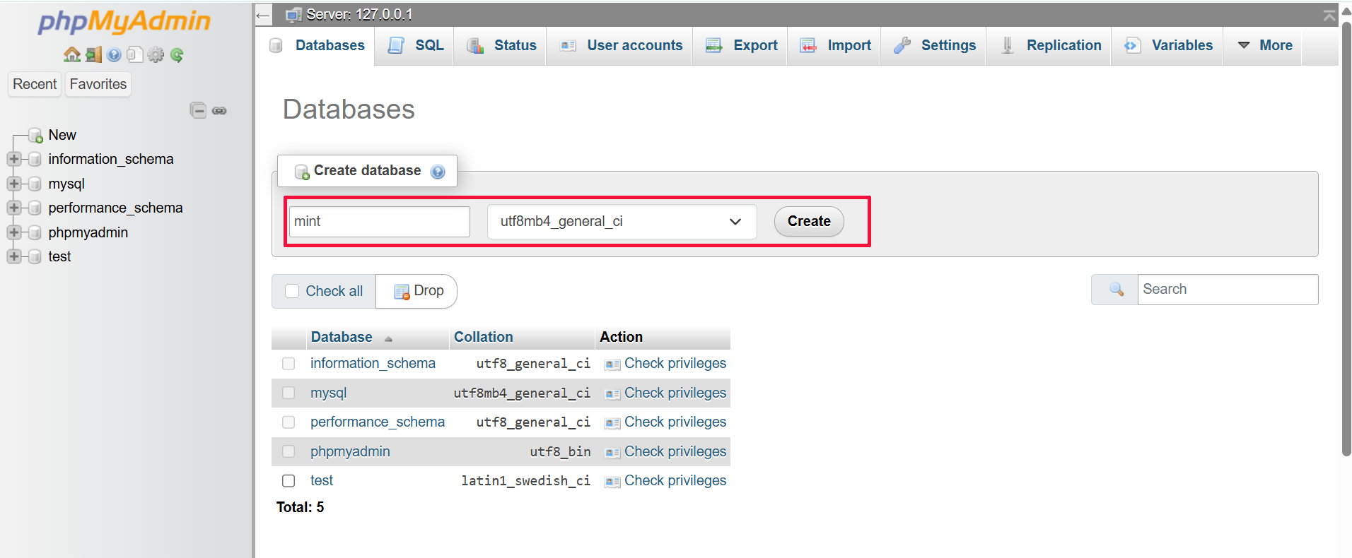
Open phpMyAdmin Open browser → Go to http://localhost/phpmyadmin. Type Database Name and Click on Create

Slide 21
Backup ...
Export the Database
Click the Export tab at the top.
Choose:
Export method: Quick
Format: SQL
Click Go to download .sql file.
Save the file in a known folder (e.g., Documents/backups/).

Slide 22
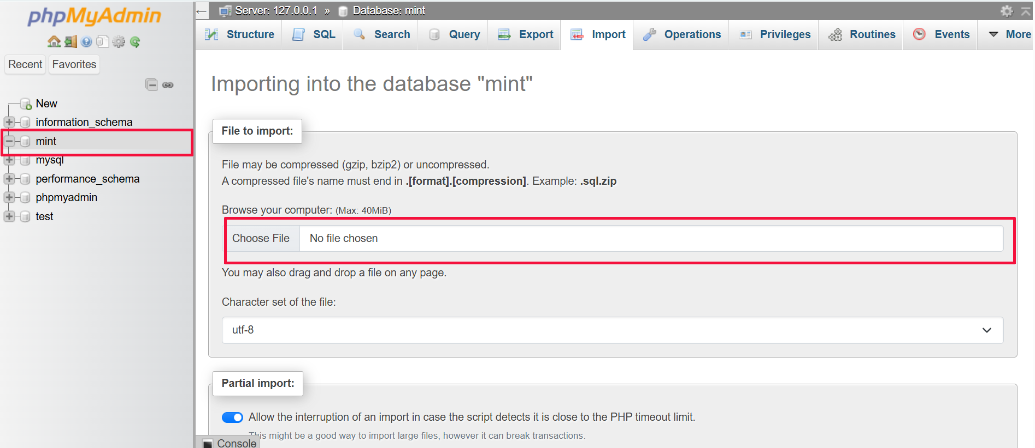
Create and Select the Database From the left sidebar, click on the database you want to back up.

Slide 23
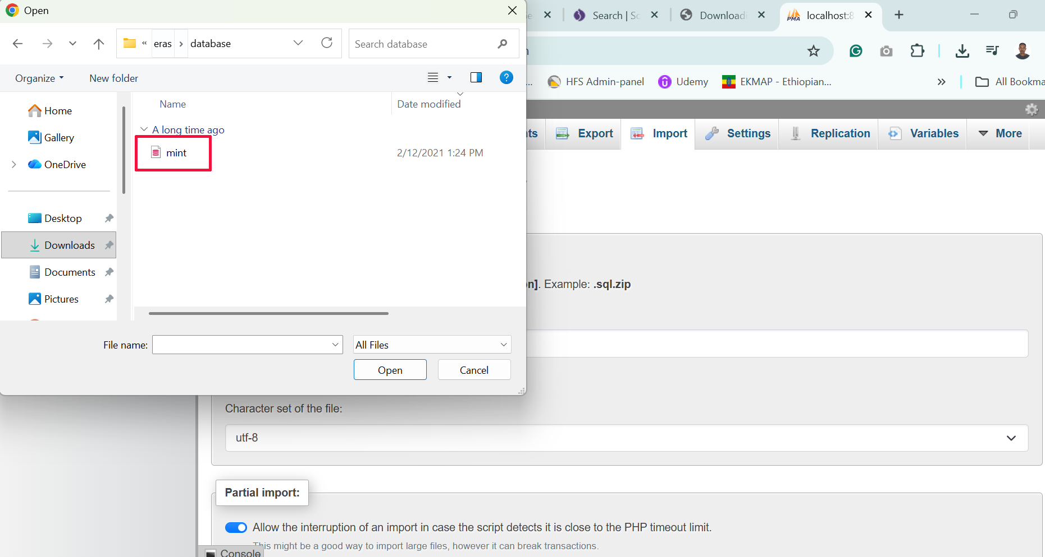
Select the database and click on OK

Slide 24
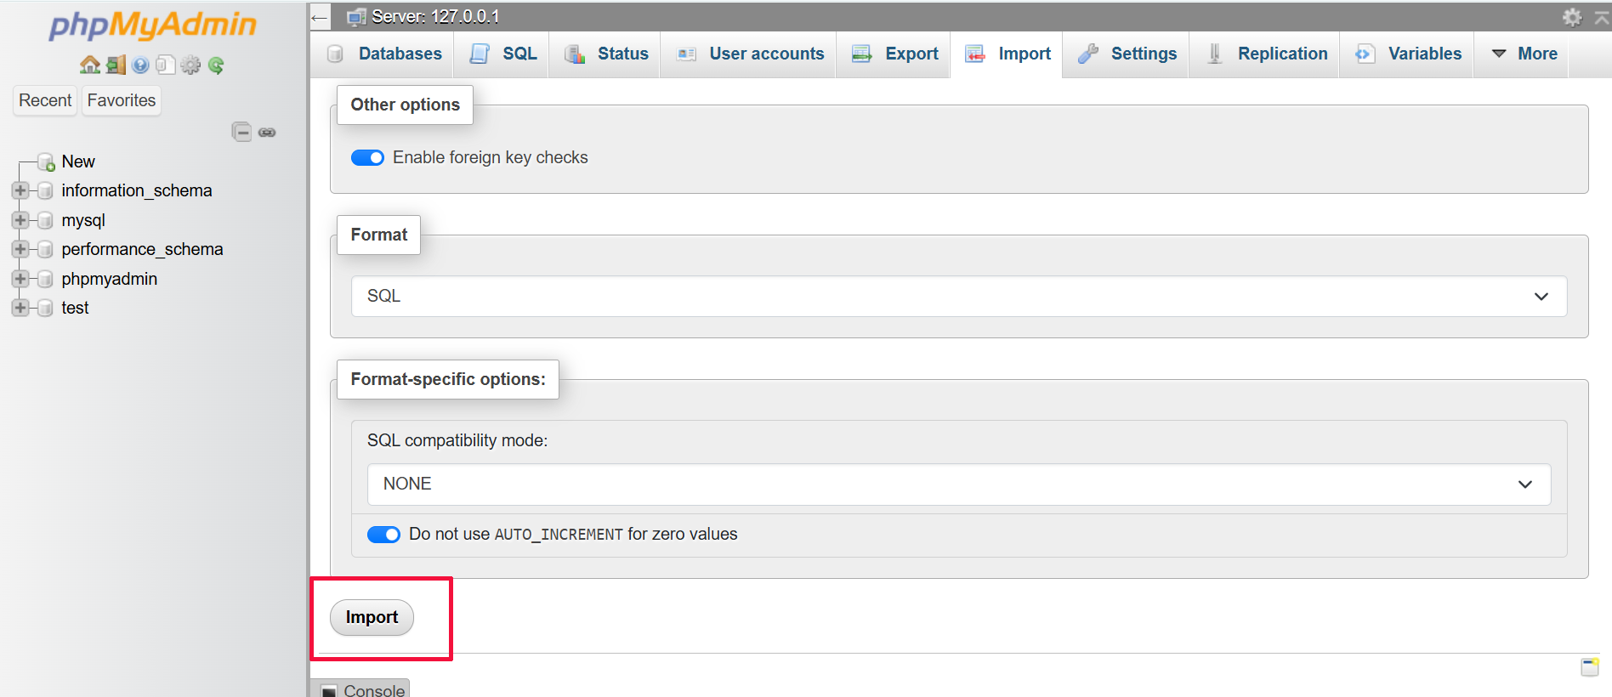
After Select the database click on Import

Slide 25
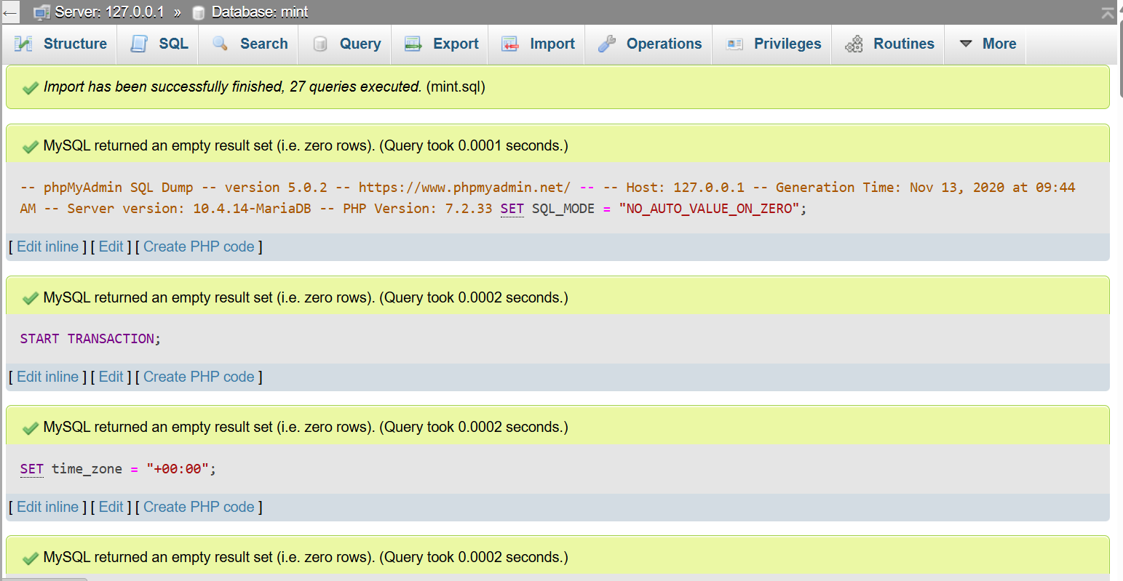
Congratulations! The database was imported successfully.

Slide 26
Upload Project to htdocs Folder
Step 1: Locate htdocs Folder
Go to: C:\xampp\htdocs
Step 2: Copy Your Project
Copy your entire web project folder into htdocs.
Example: C:\xampp\htdocs\dlc

Slide 27
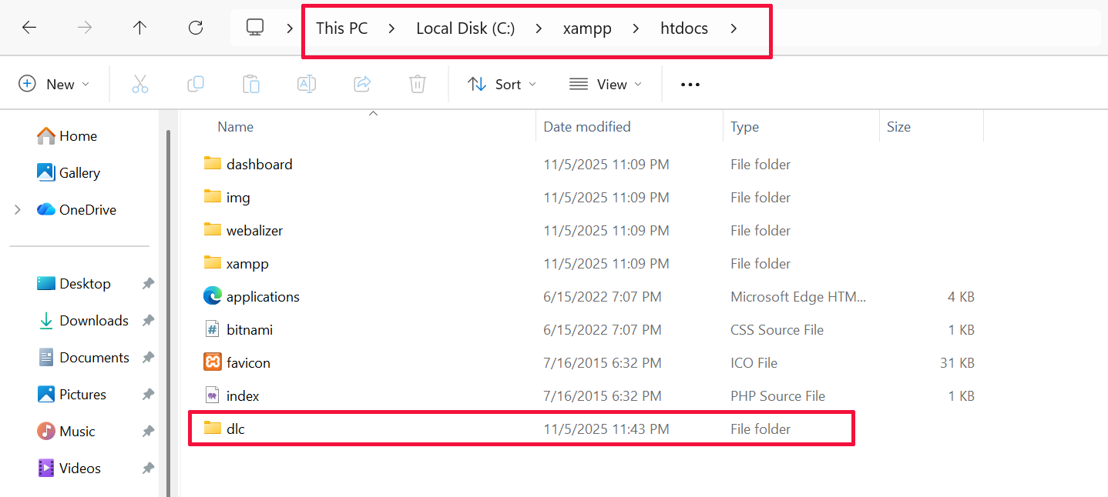

Slide 28
Step 3: Set up Entry Point
Ensure the main file is index.php or update .htaccess to point correctly.
Update config.php or .env with:
DB_HOST = localhost
DB_USER = *******
DB_PASSWORD = '******'
DB_NAME = mint_db

Slide 29
Access Project
Open your browser and go to:
http://localhost/dlc
The site should load if the setup is correct.

Slide 30


Slide 31
Changing the default port numbers
Changing the default port numbers in XAMPP is a common troubleshooting step, especially when the default ports
(Apache: 80/443, MySQL: 3306) are already in use by other software (like Skype or another MySQL installation).
You need to change the port for Apache (the web server) and potentially MySQL (the database).

Slide 32
A. Modify httpd.conf (HTTP Port 80)
Open the XAMPP Control Panel.
Click the Config button next to the Apache module and select httpd.conf.
In the text editor, find and change the following two lines to your desired port (e.g., 8080):
Find: Listen 80 Change to: Listen 8080
Save and close the file.

Slide 33
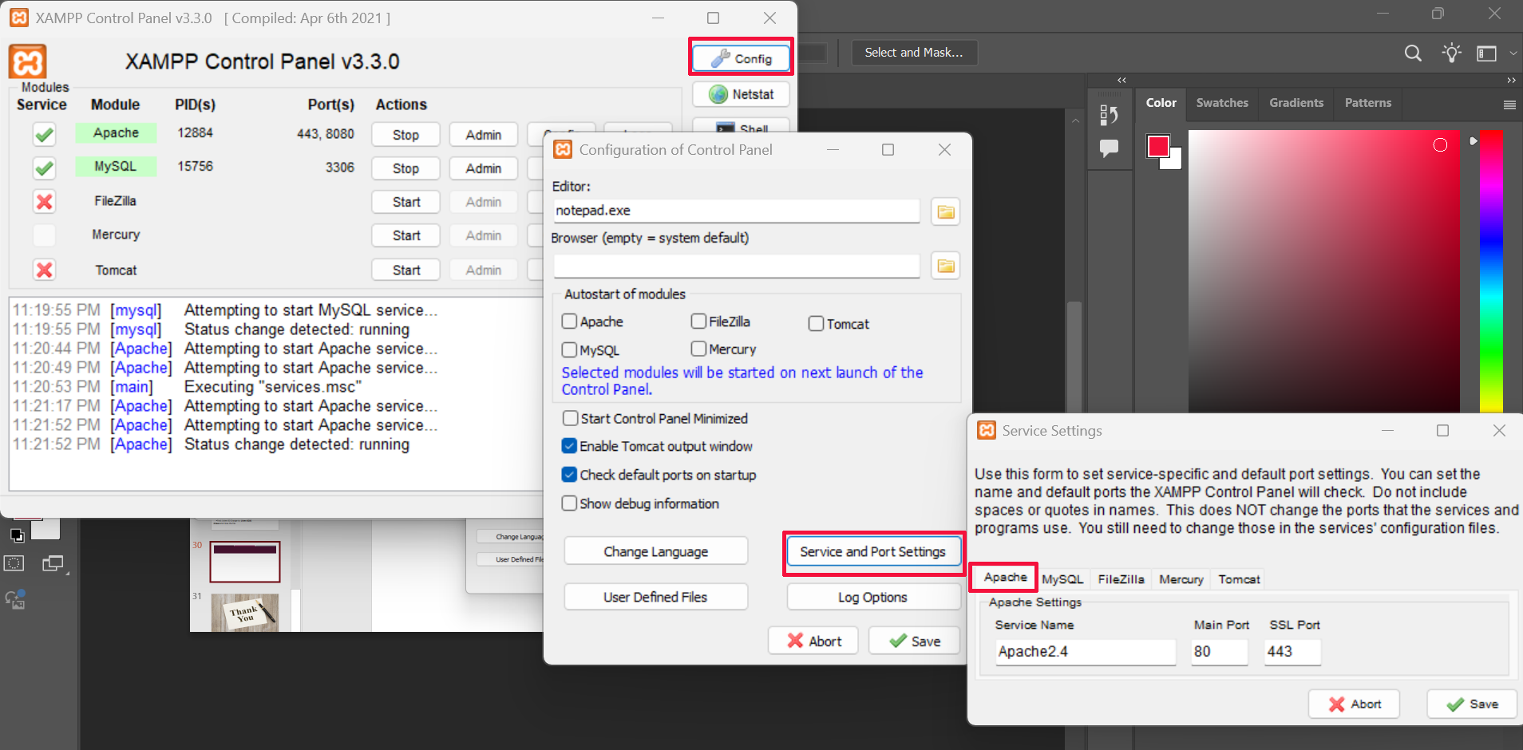

Slide 34
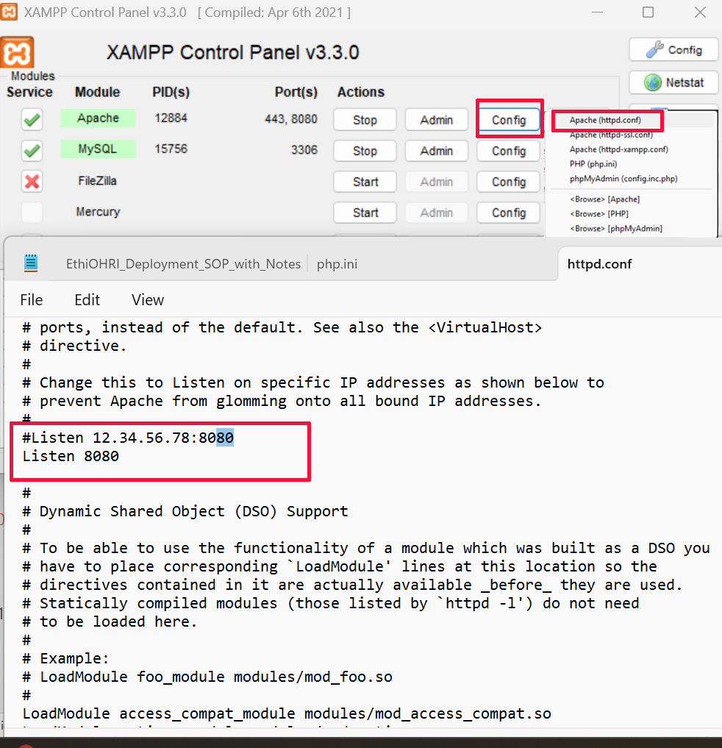
Open the XAMPP Control Panel.
Click the Config button next to the Apache module and select httpd.conf.
In the text editor, find and change the following two lines to your desired port (e.g., 8080):
Find: Listen 80 Change to: Listen 8080
Save and close the file.

Slide 35
Change MySQL Port
The MySQL database uses port 3306 by default.
A. Modify my.ini (MySQL Port 3306)
Open the XAMPP Control Panel.
Click the Config button next to the MySQL module and select my.ini.
In the text editor, find and change the port number (e.g., 3307) in the following two locations:
Under [client]: Find: port=3306 Change to: port=3307
Under [mysqld]: Find: port=3306 Change to: port=3307

Slide 37
To export a database from XAMPP, you'll primarily use phpMyAdmin, the web interface for managing your MySQL/MariaDB databases. This process creates a .sql file containing all the database structure and data.
Start XAMPP Modules:
Open the XAMPP Control Panel.
Ensure both the Apache and MySQL modules are running (they should have green status indicators).
Access phpMyAdmin:
Click the Admin button next to the MySQL module in the XAMPP Control Panel, or open your web browser and go to http://localhost/phpmyadmin/.

Slide 38
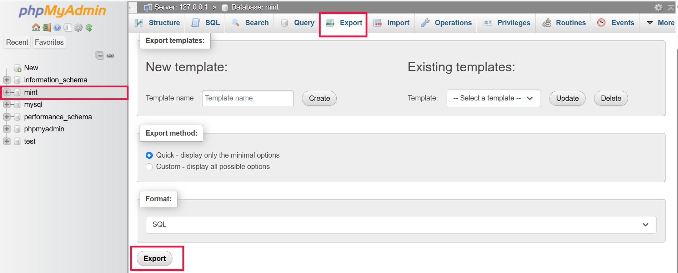
Select the Database:
In the left sidebar of the phpMyAdmin interface, click the name of the database you want to export.
Go to Export Tab:
After selecting the database, click the Export tab at the top of the main window.

Slide 39
Session - 3
Common
Learning Objectives: Basic XAMPP Errors and How to Solve Them
By the end of this lesson/module, learners will be able to:
Identify common XAMPP errors that occur during installation, startup, or usage (e.g., Apache not starting, MySQL not responding, port conflicts).
Explain the causes of basic XAMPP errors, including issues with port allocation, missing files, configuration errors, or permission problems.
Use the XAMPP Control Panel logs to diagnose and interpret error messages effectively.
Apply troubleshooting techniques to fix common problems such as:
Changing default ports (e.g., Apache from port 80 to 8080).
Reconfiguring MySQL settings when the service fails to start.
Resolving conflicts with other applications (e.g., Skype, IIS).
Modify configuration files (e.g., httpd.conf, my.ini) to resolve startup and service errors.

Slide 40
Exercise 2: Backing Up and Restoring a Database in XAMPP Objective: To practice creating a backup of a MySQL database using phpMyAdmin in XAMPP, and to restore the database from that backup file.

Slide 41
Common Error

Slide 42
Common Error 1: Apache Fails to Start (Port Conflict)
Error Message:
[Apache] Error: Apache shutdown unexpectedly.
[Apache] Problem detected! Port 80 in use by "..." (or Port 443)
This happens because another application (often Skype, IIS, or a pre-installed Windows service like "World Wide Web Publishing Service") is using the default ports needed by Apache (80 for HTTP, 443 for HTTPS).

Slide 43
Solution
Method | Steps
A. Change Apache Ports | The most common and permanent fix. Change the default ports (80 and 443) to something unused (e.g., 8080 and 4433). See the previous response for a full guide on changing ports. Remember to access your dashboard using http://localhost:8080/ afterward.
B. Disable Conflicting App | 1. Click the Netstat button in the XAMPP Control Panel to see which application is using Port 80 or 443. 2. Close the conflicting application (e.g., Skype) completely, or disable the offending Windows service (search for "Services" and look for "World Wide Web Publishing Service"). 3. Restart Apache.

Slide 44
Common Error 2: MySQL Shuts Down Unexpectedly
Error Message:
[mysql] Error: MySQL shutdown unexpectedly. [mysql] This may be due to a blocked port, missing dependencies, improper privileges, a crash, or a shutdown by another method.
This is usually caused by either a port conflict (Port 3306) or a corrupted database file.

Slide 45
Method | Problem | Steps
A. Change MySQL Port | Port 3306 Conflict. Another database or service is using the default MySQL port. | Change the MySQL port to an unused port (e.g., 3307) in the my.ini file and update the port in phpMyAdmin's configuration (config.inc.php).
B. Fix Data Corruption | Corrupted Database Files. This often happens after a system crash or unexpected shutdown. | 1. Stop MySQL. 2. Navigate to your XAMPP folder (xampp/mysql/). 3. Rename the data folder to data_old. 4. Copy the contents of the backup folder into a new empty data folder. 5. Copy all your existing database folders (the custom ones you created) from data_old into the new data folder (except for the built-in folders like mysql, phpmyadmin, etc.). 6. Restart MySQL.
C. Run as Administrator | Permission Issues. Windows is blocking MySQL from accessing necessary files. | Right-click the XAMPP Control Panel icon and select "Run as administrator."

Slide 46
Common Error 3: Cannot Import Large Database (PHP Limits)
Problem: You receive errors like "Maximum execution time exceeded" or your database import/file upload fails midway. This is because PHP has restrictive limits by default.
Solution: Increase PHP Limits
Open the XAMPP Control Panel.
Click the Config button next to the Apache module and select php.ini.
In the editor, search for and increase the values for the following directives (recommended values shown):

Slide 47
Directive | Default Value | Recommended Value for Development
max_execution_time | 30 | 120 (Seconds)
post_max_size | 8M | 128M (MegaBytes)
upload_max_filesize | 2M | 128M (MegaBytes)
memory_limit | 128M | 256M (MegaBytes)

Slide 48
Error 5: "Object Not Found!" (404 Not Found)
This is a common issue when trying to access a project and is almost always a path or configuration problem.
Cause | Solution
Incorrect URL Path | Check your browser URL. It must exactly match the folder structure inside your htdocs directory. (e.g., http://localhost/my-project/index.php).
Missing Index File | If you navigate to http://localhost/my-project/ and get a 404, ensure there is an index.php, index.html, or index.htm file directly in the my-project folder.
Virtual Host Misconfiguration | If you are using custom virtual hosts (like http://myproject.local), check the httpd-vhosts.conf file for typos in the DocumentRoot path or ServerName.
Case Sensitivity (Linux/macOS) | Unlike Windows, file systems on Linux and macOS are case-sensitive. myproject/ is different from MyProject/. Ensure all folder and file names in your URL match their actual capitalization.

Slide 49


